Slide 1
Risk Analysis
Professional Skills – Module 5

Slide 2
Professional Skills Module 5 contents
Introducing Risk Management
Risk Management Stages

Slide 3
Introducing Risk Management
Professional Skills – Module 5: Risk Management

Slide 4
Why could a project fail?
There are many reasons as to why a project could fail, including:
Lack of clear objectives
Required deliverables not fully described
Poor management of changes
No effective project plan
Poor communication
One of the bigger reasons, and the one this session will focus on, is risk management

Slide 5
Task: Defining Risk
Create a definition for risks
2 mins, pairs
Write your definition for risk
List some examples of risks for any generic IT system

Slide 6
What is Risk?
A risk is defined by Association for Project Management (APM) as
“An uncertain event or set of circumstances that would, if it occurred, have an effect on achievement of one or more objectives”
For every threat of a risk, there is an opportunity to mediate that risk
This is the process of risk management
Risk Management is defined by APM as
“A process that allows individual risk events and overall risk to be understood and managed proactively, optimising success by minimising threats and maximising opportunities.”

Slide 7
Components of a Risk
Cause
The source of the risk, the situation that can present the risk
Event
Description of the area of uncertainty
Effect
The impact of that risk occurring

Slide 8
Risk Management Stages
Professional Skills – Module 5: Risk Management

Slide 9
Risk Management process
Risk Analysis
Risk Management
Identify
Assess
Plan
Manage
The process actually has 2 phases to consider; the analysis process and management process
Identifying and assessing risks are part of risk analysis
Planning for the risk and managing it are part of risk management

Slide 10
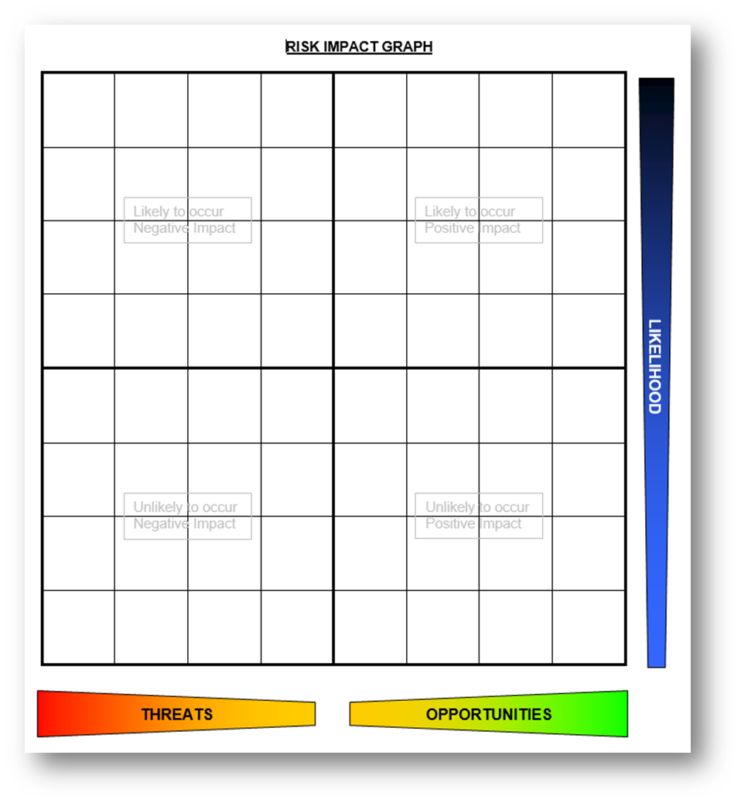
Identifying Risk
Identifying risk can be as simple as listing potential opportunities and threats to a project
This could be recorded into a Risk Register, with data around a Unique ID, Author, Date Identified and Current Status
We should also identify a Risk owner
This is a person that is best placed to keep an eye on the risk, monitor it and report back to the Project Manager when needed

Slide 11
The Risk Register
Risk Registers typically consist of three columns; impact, mitigation, outcome
Impact – The effect on the flow of business execution and project execution
Mitigation – The steps we can take to reduce if not entirely mitigate the risk
Outcome – Positive/Negative outcome, and next steps if the risk was to occur
A lot of risks in the risk register can be project agnostic
Many risks will be entirely project specific, but there are other more general risks that can be for any and all projects, such as testing coverage
This saves time taken for risk management in future projects!
Notes:
PLANNING – I have planned a bit – Planning phase not complete. PLANNING – I haven’t plotted a timeline yet – Plot a timeline.
TESTING – I need to cover different tiers of architecture – Use surefire/sonarqube/selenium.
TESTING – I need to cover 80% - Regular surefire/sonarqube tests. PRESENTING – Unknown audience – Find out who the audience is. USER EXPERIENCE – Looks bland – Enhance CSS.

Slide 12
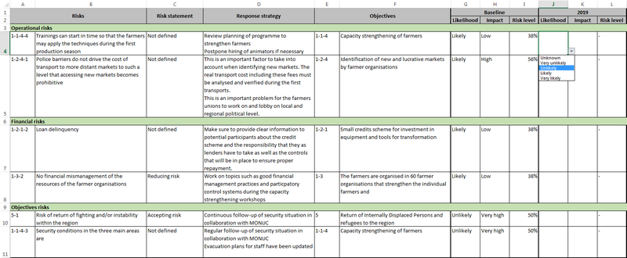
Risk Register - example

Slide 13
Assessing Risk
We need to consider the probability, impact and proximity of a risk – this is how we assess them
Probability – the likelihood of the risk actually happening
Impact – the result of the risk coming to fruition
Proximity – when the risk may occur
It could also be helpful knowing how often the risk could occur
Easy ways to assess these risk could be through
Models
Simulations
Critical Path or Sensitivity Analysis

Slide 14
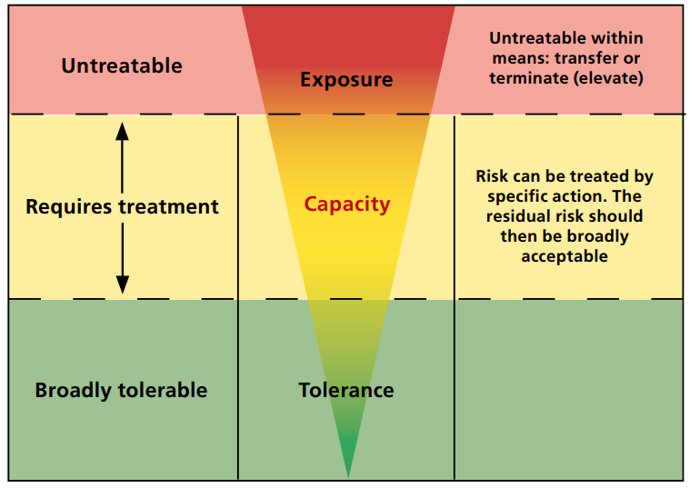
Risk Analysis diagram
TRANSFER TERMINATE
TREAT TAKE
TOLERATE
Risk Tolerance

Slide 15
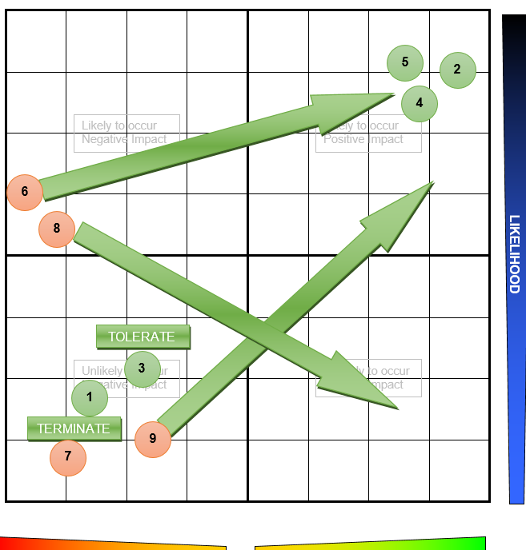
Planning for risks
We should plan for a risk and understanding how we deal with it
Different planning strategies for different risks
All should be considered within a project
Consider the plotted graph (right) with the following risk scenarios:
Lack of clear planning
Incorrect understanding of API development
Repository mis-management
Lack of project scope understanding
Presentation questions
M2M relationships in a database
GCP/Jenkins issues
Lack of audience understanding for presentation
Illness or lack of sleep before presentation

Slide 16
Summary
Risks are commonplace within a project; managing that risk for a successful project is paramount
Risks will have some kind of cause, event and effect
Risk management can be broken down into two distinct stages; analysis and management
Analysis involves identifying and assessing risks
Management involves planning and managing risks
Professional Skills – Module 5

Slide 17

Thank you for listening
QA hopes you enjoyed your course, as much as we enjoyed teaching you.

